Slide 1
Call1800.org

Slide 2
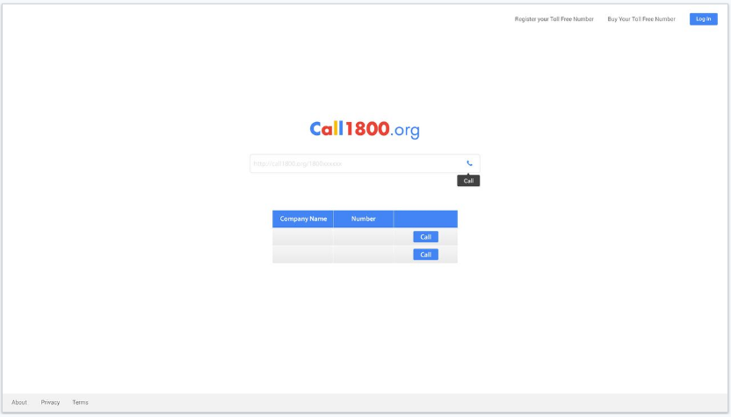
Theme use
It is web portal and everyone will be able to come here and can call any Toll free number.
If anyone enters 18xx-xxx-xxxx then it should show call button
If there is any alphabet in enter field, then it should show search option and after search it will check directory and pop them up
In the bottom, it should show most dialed TF numbers and direct option to call
Notes:
It is web portal and everyone will be able to come here and can call any Toll free number.
If anyone enters 18xx-xxx-xxxx then it should show call button
If there is any alphabet in enter field, then it should show search option and after search it will check directory and pop them up
In the bottom, it should show most dialed TF numbers and direct option to call

Slide 3
Toll Free Number Registrar
Register Your Number
Company Name
Toll Free Number
It will open when someone click on register your own toll free number
It will ask for Company name , toll free number, Address, city, state, country & zip. Mandatory field is only Company name and toll free. Others will be optional
Notes:
It will open when someone click on register your own toll free number
It will ask for Company name , toll free number, Address, city, state, country & zip. Mandatory field is only Company name and toll free. Others will be optional

Slide 4
Choose Your Number
1800, 1888, 1866,1877,1855,1844
[ ]
[ ]
[ ]
[ ]
[ ]
Number | Monthly Fee | Per Minute Fee
 | 1 | 0.015
 | 1 | 0.015
 | 1 | 0.015
 | 1 | 0.015
 | 1 | 0.015
Confirm
This page will open when someone will click on buy your own Toll free number
First box with 1800, 1888, 1866,1877,1855,1844 will be in dropdown to select Toll Free number those starts with those number
Clicking on buy will open next page of this ppt.
Notes:
This page will open when someone will click on buy your own Toll free number
First box with 1800, 1888, 1866,1877,1855,1844 will be in dropdown to select Toll Free number those starts with those number
Clicking on buy will open next page of this ppt.

Slide 5
1800, 1888, 1866,1877,1855,1844
Get Your Number
Plan | Monthly Fee | Per Minute Fee
Per minute Plan | 1 | .015 USD
Buy
Plan | Monthly Fee | Per Month Fee
1000 Min | 1 | 100 USD
2000 Min | 1 | 200 USD
5000 Min | 1 | 500 USD
10000 Min | 1 | 1000 USD
Buy
Buy
Buy
Buy
100 % Completion Rate
Never Worry your client can’t find you
With Pay Per Usage, You don’t lose on monthly fee
With monthly fee, you will charge with least rates
Buy will redirect to next page.

Slide 6
New User/ Sign In
First Name
Last Name
Email
Phone Number
Address
City
State
Country
Ask for These field to fill
In the bottom “Already a client? Sign in”
Then it will ask for username & password or Email & password

Slide 7
Payment Page
First Month Toll free number Fee = 1USD
Monthly Fee = 100USD First time payment = 10 USD min & 0 for monthly (for per minute client )
Total = 101 USD
Pay with paypal
Stripe payment

